Slide 1



1
Unit 3 Section A
College life in the Internet age
FOREIGN LANGUAGE TEACHING AND RESEARCH PRESS
AIR FORCE ENGINEERING UNIVERSITY
Notes:
1

Slide 2
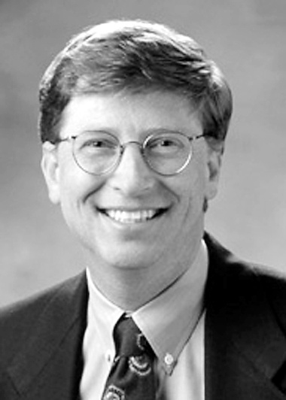
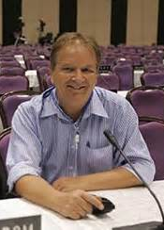
1
3
UNIT
I think it’s fair to say that personal computers have become the most empowering tool we’ve ever created. They’re tools of communication, they’re tools of creativity, and they can be shaped by their user.
— Bill Gates
The Internet is so big, so powerful and pointless that for some people it is a complete substitute for life.
— Andrew Brown
Notes:
2

Slide 3

^{Section A}
1
3
Digital campus
UNIT
College life in the Internet age
To talk about digital education
Objectives
To further understand the text
To apply the phrases and patterns
To master the paragraph writing skill

Slide 4






College life in the Internet age
Section A
Contents
Warming-up activities
Text study
Language application
Summary

Slide 5



College life in the Internet age
Section A
Warming-up activities
Lead-in
Pre-reading activities
Cultural background

Slide 6
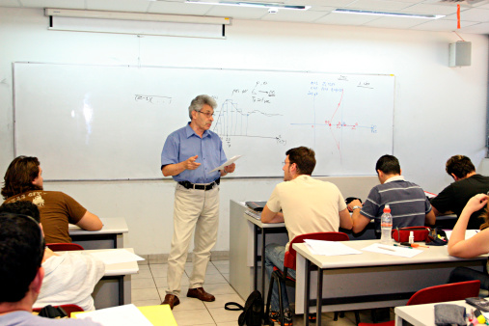
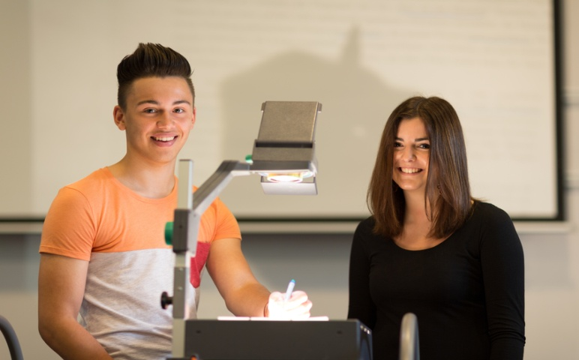

Lead-in
Short answer questions
Look at the following 3 pictures and answer the questions based on these pictures.

Slide 7

Lead-in
Short answer questions
1. What are the advantages and disadvantages of each way of teaching and learning?
Tips
Traditional classroom
Advantages:
· more direct communication between teachers and students;
· a better learning atmosphere.
Disadvantages:
· little interaction either among students or between students and the teacher;
· teachers tending to dominate the class;
· writing on blackboard reducing efficiency.

Slide 8
Lead-in
Short answer questions
1. What are the advantages and disadvantages of each way of teaching and learning?
Tips
Multimedia classroom
Advantages:
· more vivid teaching materials;
· students better engaged in classroom learning.
Disadvantages:
· too many distractions with too many pictures and videos in multimedia classrooms.

Slide 9
Lead-in
Short answer questions
1. What are the advantages and disadvantages of each way of teaching and learning?
Tips
Studying online in the dorm
Advantages:
· being able to choose when and what you want to learn;
· easy access to the wide range of online information
Disadvantages:
· making it easier for students to copy answers from the Internet;
· lack of face-to-face communication between the teacher and student;
· the possibility for students to develop Internet addiction.

Slide 10
Lead-in
Short answer questions
2. Which way do you prefer? Give your reasons.
Tips
I prefer the multimedia way of learning:
· it is vivid with teaching materials presented in different ways
· Compared with traditional classroom, it is more interesting.
I prefer to study online:
· manage my own time
· have my own properties
· do things at my own pace

Slide 11
Lead-in
Short answer questions
3. Do you think the Internet is indispensable in teaching and learning nowadays? Why or why not?
Tips
The Internet is indispensable:
· get access to the latest development of teaching and learning;
· enjoy many interesting online courses
· communicate with teachers after class
The Internet is not indispensable:
· teaching and learning have been carried out long before the Internet came into being;
· teaching and learning could surely continue without the Internet.

Slide 12
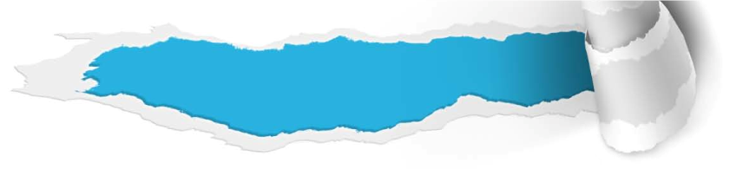

Pre-reading activities
Listen and talk
Listen to an introduction to the educational technology and then write down the English version of the following tools and techniques.

Slide 13

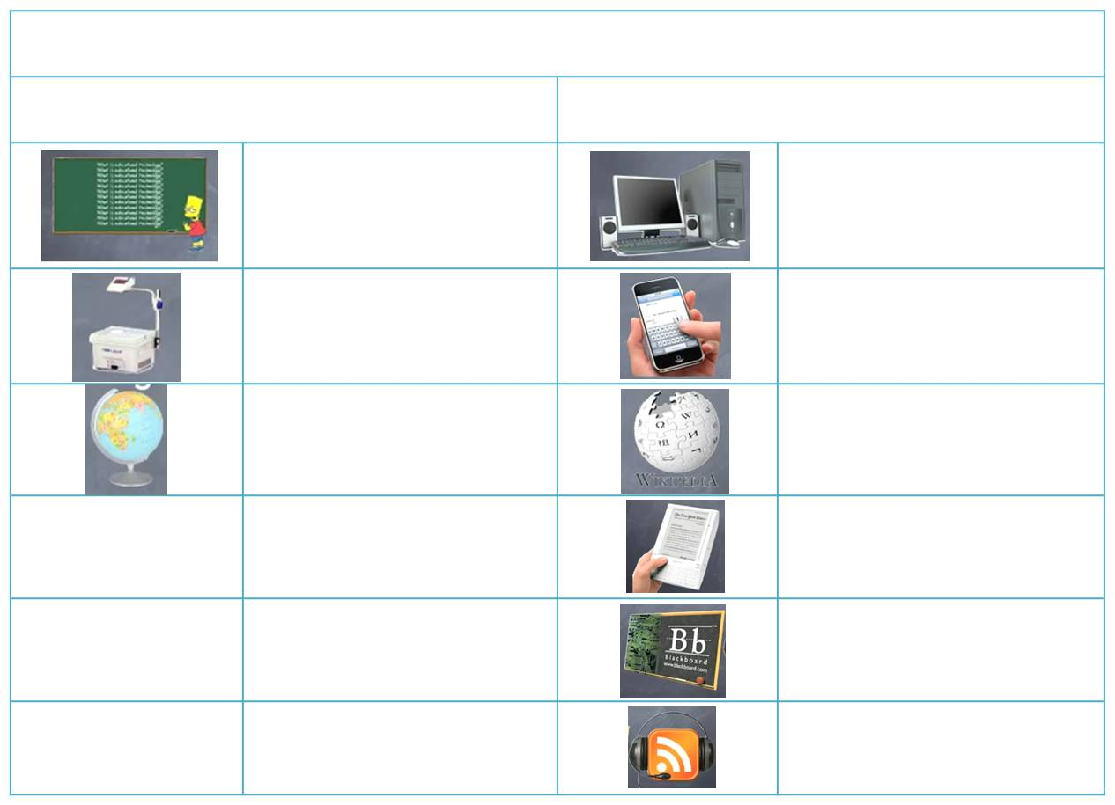

Pre-reading activities
Listen and talk
Just what is educational technology?
Traditional
Present
chalkboard
computers
Internet
mobile computing
projector
maps
and globes
open content
electronic
books
course
management
systems
podcasts

Slide 14


Pre-reading activities
Compound dictation
Listen to a short passage concerning digital education and fill in the missing information.
This is the VOA Special English Education Report.
We ___________ a question from a listener in the West Bank about how American schools use _____________ technology. There is not a simple answer. It depends on the subject and level of students, of course.
received
educational

Slide 15
Pre-reading activities
Compound dictation
Listen to a short passage concerning digital education and fill in the missing information.
But it also depends on the interest and ___________ of the teachers, and the goals and budgets of the schools. Schools are almost all _____________ to the Internet. But some have more technology, and use it more, than others.
training
connected

Slide 16
Pre-reading activities
Compound dictation
Listen to a short passage concerning digital education and fill in the missing information.
For example, some schools use computers for _____________ like video conferencing, to bring the world into the classroom. And some classrooms ___________________ things like a Smart Board, a kind of interactive whiteboard. Interactive whiteboards are large ___________ for presentations.
activities
are equipped with
displays

Slide 17
Pre-reading activities
Compound dictation
Listen to a short passage concerning digital education and fill in the missing information.
They connect to a computer and can ___________ by touch. They can be used for documents or writing or to ________ video. Some teachers are trying _________ new ways to teach with devices like iPods and mobile phones. But educators say the most important thing, as always, is the ________.
operate
project
creative
content

Slide 18
Cultural background
Advanced digital technology
Questions Previewing
1. According to your own knowledge, what is smartphones?
2. Can you name and introduce some famous companies that produce smartphones?

Slide 19


Cultural background
Advanced digital technology
According to your own knowledge, what is smartphones?
Tips
A smartphone is a device:
· make phone calls;
· send and receive email;
· edit Office documents;
· access the Web at higher speeds

Slide 20

Cultural background
Advanced digital technology
2. Can you name and introduce some famous companies that produce smartphones?
Tips
Apple Inc:
·an American multinational corporation headquartered in California;
·designs, develops, and sells consumer electronics, computer software and personal computers;
·best-known products include: iPod, iPhone, iPad, Macline of computer;
·software include: OS X and iOS operating
system, iTunes, Safari, iLife, iWork
BlackBerry Limited:
· a line of mobile email and smartphone devices;
· developed and designed by Canadian company Research In Motion (now BlackBerry Limited)
· function as digital personal assistants, portable media players, Internet browsers, gaming devices

Slide 21


College life in the Internet age
Section A
Text study
Main idea & structure
Language focus
Critical thinking

Slide 22
Main idea & structure
Main ideas of the parts
Listen to the tape, fill in the missing words of the following paragraph.
The college campus, long a place of scholarship and frontiers of _______________, is being transformed into a new age of ____________ by a fleet of __________, _____________ and ____________ 24 hours a day. (Para.1)
new technology
electronics
laptops
smartphones
connectivity

Slide 23

Main idea & structure
Main ideas of the parts
Can you find out the common point of these above missing words? (Para.1)
Tips
digital technology
Conclusion:
college campus → transform into → digital campus
Notes:
23

Slide 24

Main idea & structure
Main ideas of the parts
Part I — (Para. __)
1
The college today is being transformed into _____________________ by a fleet of laptops, smartphones and Internet connection 24 hours a day.
a new age of electronics

Slide 25
Main idea & structure
Main ideas of the parts
How do students use new technologies in and out of class? (Para. 2)
take notes or send instant-messages with laptops
make calls with cellphones
enjoy music with iPods wherever they go
Wireless Internet
Notes:
25

Slide 26
Main idea & structure
Main ideas of the parts
How do students feel about wireless Internet access? (Para. 4)
Tips
a means of communication
“I always feel like I have ___________________
_______________― in class and out of class,” says one biology major.

Slide 27
Main idea & structure
Main ideas of the parts
Can you supply some specific examples on how the teachers and students use new technology? (Para. 5)
practice the foreign language
tape lectures
record scripts
analyze music
post online
record their own radio shows
teachers
students

Slide 28
Main idea & structure
Main ideas of the parts
Why is non-stop Internet connection becoming indispensable for the storage and management of the information? What is the advice offered by the writer? (Para. 6)
Tips
Reasons:
· to do homework
· review lecture online
· take part in class discussions
Advice:
· do not make the Internet just your toy or let the online world take you away from the real world

Slide 29
Main idea & structure
Main ideas of the parts
Part II — (Paras. 2-6)
Colleges have become the ___________
_______________________ in the world. And this digital transformation has brought students ___________________ for their learning and lives.
most Internet-accessible spots
various conveniences

Slide 30
Main idea & structure
Main ideas of the parts
How fast has information technology developed on campus? (Para. 7)
Tips
Time | Content | Budget
mid-1990s
past few years
many began wiring dorms with high-speed connections
2% to 3%
schools have taken the lead by turning their campuses into bubbles of Wi-Fi networks
5% to 8%
Notes:
30

Slide 31
Main idea & structure
Main ideas of the parts
What did the universities do in order to maintain their competitive advantage? (Paras. 8-11)
free BalckBerry email devices
Wi-Fi
free Apple iPod
VoIP
competitive advantage
own or lease a laptop
computer labs
the focus on technology
repair shops

Slide 32
Main idea & structure
Main ideas of the parts
Part III — (Paras. 7-11)
The ___________________________ has developed fast on campus. In order to ____________________________________ and attract students, colleges are competing with _______________________________.
information technology
maintain their competitive advantage
the best Internet services

Slide 33
Main idea & structure
Main ideas of the parts
Listen to the tape, fill in the missing words of the following paragraph.
replacing
Colleges around the world have been _____________ their computer systems for the past decade, in large part to provide students with the _______________________. The anywhere-anytime access has already ______________________ in education. With the ____________________ of computer technologies, we are going to produce a generation of _______________ and ________________, which is indispensable for the future of the world. (Para.12)
most advanced free system
yielded amazing benefits
widespread application
problem-solvers
intelligent thinkers

Slide 34
Main idea & structure
Main ideas of the parts
Part IV — (Para. 12)
The anywhere-anytime access has already _______________________ in education. With the widespread application of digital technology, we are going to produce ____________________________________
_________________.
yielded amazing benefits
a generation of problem-solvers and intelligent thinkers

Slide 35
Main idea & structure
Structure of the text
Introduction
The college today is being transformed into a new age of electronics by a fleet of laptops, smartphones and Internet connection 24 hours a day. (Para. 1)

Slide 36
Main idea & structure
Structure of the text
Introduction
How the transformation
influences student’s campus life
How students use new technologies in and out of class. (Para. 2).
Colleges have become the most Internet-accessible spots in the world. (Para. 3)
How students feel about wireless Internet access. (Para. 4)

Slide 37
Main idea & structure
Structure of the text
Introduction
How the transformation
influences student’s campus life
Specific examples on how the new electronic device helping students’ learning. (Para. 5)
Why non-stop Internet connection is becoming indispensable for the storage and management of information. (Para. 6)

Slide 38
Main idea & structure
Structure of the text
Introduction
How the transformation
influences student’s campus life
How the transformation
influences college
How fast information technology has developed on campus. (Para. 7)
The Internet has brought students various conveniences. (Para. 8)

Slide 39
Main idea & structure
Structure of the text
Introduction
How the transformation
influences student’s campus life
How the transformation
influences college
Some universities try their best to maintain competitive advantage. (Para. 9)
To attract students, colleges are competing with the best Internet services, and another example of how colleges help students. (Para. 10-11)

Slide 40
Main idea & structure
Structure of the text
Introduction
How the transformation
influences student’s campus life
How the transformation
influences college
Conclusion
The anywhere-anytime access has yielded amazing benefits. With the widespread application of laptops and computer sciences, we’re going to produce a generation of problem-solvers and intelligent thinkers, which is indispensable for the future of the world. (Para. 12)

Slide 41
Main idea & structure
Summary of the text
College life in the Internet age
The colleges today have become the ________________________ in the world. The Internet has brought students __________________ for their learning and lives. Students __________________ to each other, to professors and to their classwork in an ____________________
__________________________.
most Internet-accessible spots
various conveniences
are electronically linked
ever-flowing river of information and communication

Slide 42
Main idea & structure
Summary of the text
For universities, to _________________
____________________ and attract students, they are competing with the best Internet services. _______________
______________________ laptops and computer sciences, the universities are going to produce a generation of ________________________________, which is indispensable for the future of the world.
maintain their competitive advantage
With the widespread application of
problem-solvers and intelligent thinkers

Slide 43
Language focus
Practical phrases
Practical Phrases | Specific Meanings
1. access | 享用权；享用机会
2. take the lead | 树立榜样；带头
3. account for | 是……的原因；引起；解释；说明
4. inferior | 差的；次的
5. focus on | （把……）集中（于）
6. keep up with | ①跟上；保持同步； ②和（朋友）保持联系
7. stand out | ①出色；②显眼；突出
8. replace with | 用……替换；以……接替

Slide 44

Language focus
Practical phrases
享用权；享用机会
access
短语逆译
短语应用
利用最新信息对我们的研究至关重要。
意群提示
(access to /up-to-date/essential/research )
Access to up-to-date information is essential to our research.

Slide 45
Language focus
Practical phrases
树立榜样，带头
take the lead
短语逆译
短语应用
主席做事总是一马当先，深受广大群众信任。
意群提示
(take the lead / deeply trusted/ the masses)
The chairman always takes the lead in everything and is deeply trusted by the masses.

Slide 46
Language focus
Practical phrases
解释，说明，引起
account for
短语逆译
短语应用
很多国家都在尽力弄清楚MH370失踪的原因。
意群提示
(try to/ find out/account for/ disappearance)
Many countries are trying to find out what accounts for the disappearance of MH370 airplane.

Slide 47
Language focus
Practical phrases
差的，次的
inferior
短语逆译
短语应用
认为女性的智力低于男性的想法是愚蠢的。
意群提示
(stupid/ inferior/ intelligence)
It is stupid to think that women are inferior in intelligence to men.

Slide 48
Language focus
Practical phrases
（把…… ）集中（于）
focus on
短语逆译
短语应用
优质价廉的商品令万众瞩目。
意群提示
(focus attention on/ commodities/ quality/ price)
Millions of people focus their attention on commodities which are good in quality and low in price.

Slide 49
Language focus
Practical phrases
①跟上；保持同步；
②和（朋友）保持联系
keep up with.
短语逆译
短语应用
现在的年轻人可以通过更多的方式和朋友们保持联系。
意群提示
(means/ keep up with with)
Young people now have more and more means to keep up with their friends.

Slide 50
Language focus
Practical phrases
①出色；
②显眼；突出
stand out
短语逆译
短语应用
她那长长的金发和鲜亮的粉色裙子使她在人群中显得很突出。
意群提示
Her long, blonde hair and bright pink dress made her stand out in the crowd.
(blonde/ bright pink/ stand out/ crowd)

Slide 51
Language focus
Practical phrases
用……替换
以……接替
replace with
短语逆译
短语应用
很多人相信信用卡替代现金只是个时间问题。
意群提示
(a matter of time/ replace with/ cash/ credit card)
Many people believe that it will be a matter of time before they completely replace cash with credit cards.

Slide 52
Language focus
Functional patterns
Functional Patterns | Functions & Usages
1. Sth., long a … of …, is being transformed into …, and … | 用于形容“某物的转变或变化”。
2. A recent study/ research/ experiment found/ discovered/ indicated that … | 用于表达“某些研究、实验等所发现的结果”。
3. With the widespread application of …/ With the fast/rapid development of … | 用于表达“某事或某物的发展或应用”。
Notes:
52

Slide 53
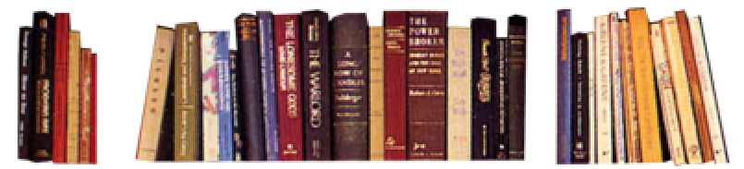
Language focus
Functional patterns
原句译文
大学校园长久以来都是学术之地，也是新技术的前沿。现在随着手提电脑和智能手机的大量出现，加上每天24小时不间断的网络连接，大学校园正在转而进入电子设备的新时代。
逆译练习
The college campus, long a place of scholarship and frontiers of new technology, is being transformed into a new age of electronics by a fleet of laptops, smartphones and connectivity 24 hours a day.
句型提炼
Notes:
53

Slide 54
Language focus
Functional patterns
句型提炼
sth., long a … of …, is being transformed into …, and …
应用提示
用于形容“某物的变化”。
句型应用
Notes:
54

Slide 55

Language focus
Functional patterns
典型例句
太空长久以来都是一个充满神秘色彩的地域，现在随着尖端技术和先进材料的大量出现，加上专业的宇航员，太空已经正在转为人类探索活动的战场。
意群提示
( mystery/ battlefield/ human exploration/ astronaut)
The space, long a place of mystery, is being transformed into a battlefield of human exploration by a fleet of top technology, advanced material and professional astronauts.

Slide 56
Language focus
Functional patterns
原句译文
事实上，美国最近的一项研究发现，信息技术的投入占高校预算的5%-8%，比20世纪80年代中期约2%-3%的投入有所增加。
逆译练习
In fact, a recent study in the US found that information technology accounted for 5% to 8% of college budgets, up from an estimated 2% to 3% in the mid-1980s.
句型提炼
Notes:
56

Slide 57
Language focus
Functional patterns
句型提炼
A recent study/ research/ experiment found/ discovered/ indicated that …
应用提示
用于表达“某些研究、实验等所发现的结果”。
句型应用
Notes:
57

Slide 58
Language focus
Functional patterns
典型例句
最近的一项研究发现，与动物进行积极的互动能降低一个人的血压。
意群提示
(interact with/ active/ lower/ blood pressure )
A recent research discovered that interacting with animals in an active way may lower a person’s blood pressure.

Slide 59
Language focus
Functional patterns
原句译文
随着计算机技术的广泛应用，我们将培养出善于解决问题和善于思考的一代人，这对于世界的未来是至关重要的。
逆译练习
With the widespread application of laptops and computer science, we are going to produce a generation of problem-solvers and intelligent thinkers, which is indispensable for the future of the world.
句型提炼
Notes:
59

Slide 60
Language focus
Functional patterns
句型提炼
With the widespread application of …/
With the fast/rapid development of …
应用提示
用于表达“某事或某物的发展或应用”。
句型应用
Notes:
60

Slide 61
Language focus
Functional patterns
典型例句
随着互联网的迅猛发展和广泛应用，网络信息安全问题变得越来越严峻。
意群提示
(seriousness/ information security/ on the rise)
With the rapid development and widespread application of Internet, the seriousness of Internet information security is on the rise.

Slide 62


Language focus
Language appreciation
欢迎来体验21世纪的大学生活：通过源源不断的信息流，学生之间、师生之间建立了电子化的联系，一天24小时，一周7天，从不间断。
a. Welcome to college life in the 21st century, where students on campus are electronically linked to each other, to professors and to their classwork 24/7 in an ever-flowing river of information and communication. (Para. 3, L1)

Slide 63
Language focus
Language appreciation
对于大多数本科生来说，永不间断的网络是大学生活的动力。
b. For most undergraduates, non-stop Internet connectivity is the fuel of college life. (Para. 6, L1)

Slide 64
Language focus
Language appreciation
在过去的几年中，学校率先把校园变成了被无线网络覆盖的世界。
c. In the past few years, schools have taken the lead by turning their campuses into bubbles of Wi-Fi networks. (Para. 7, L2)

Slide 65
Language focus
Language appreciation
大学之间用最现代的网络和最热门的系统装置来吸引学生的竞争已经达到狂热的地步。
d. The race to attract students with the most modern networks and the hottest systems has reached fever pitch. (Para. 10, L1)

Slide 66
Language focus
Language appreciation
随时随地的网络连接使教育深受裨益。
e. The anywhere-anytime access has already yielded amazing benefits in education. (Para. 12, L3)

Slide 67
Critical thinking
Theme exploration
Do you think the university should provide Internet access anywhere and anytime on campus? Why or why not?
Some people predict that in the future students will learn only at home by attending online courses. How do you like this idea?
What would life be like without the Internet or smartphones?

Slide 68

Critical thinking
Theme exploration
Do you think the university should provide Internet access anywhere and anytime on campus? Why or why not?
Tips
Yes, I think so. Internet access is a must on campus. We students need the Internet to do research for our study, to obtain information to broaden our knowledge of the world, to communicate with family and friends, and to enrich our lives in our spare time.

Slide 69
Critical thinking
Theme exploration
Do you think the university should provide Internet access anywhere and anytime on campus? Why or why not?
Tips
No, I don’t think so. There are many potential disadvantages if Internet access is so easily accessible. Some students may waste too much time in playing online games or chatting online, be tempted to visit “unhealthy” websites, or even become Internet-addicted and neglect their study.

Slide 70
Critical thinking
Theme exploration
Some people predict that in the future students will learn only at home by attending online courses. How do you like this idea?
\\
Tips
It sounds like an awful idea to me. Obtaining knowledge is only part of learning. Learning not only gives us a wealth of knowledge, it also provides us with great vision, strong principles, social abilities, good manners, interpersonal skills and many more valuable attributes. This obviously cannot be realized by learning at home only with the computer.

Slide 71
Critical thinking
Theme exploration
Some people predict that in the future students will learn only at home by attending online courses. How do you like this idea?
\\
Tips
I think it is a good idea that students can study at home via the Internet in the future. Learning would become more flexible and accessible. This way, college education could become available to many more people, old or young, near or far, healthy or handicapped.

Slide 72
Critical thinking
Theme exploration
3. What would life be like without the Internet or smartphones?
Tips
Life would be unimaginable without the Internet or smartphones. I depend on them to do everything, from study to communication, from shopping, to entertaining. Without the Internet, the banking systems, the communications systems, in fact all key aspects closely related to people’s life will collapse. Life without the Internet would be terrible and simply unimaginable.

Slide 73
Critical thinking
Theme exploration
3. What would life be like without the Internet or smartphones?
Tips
Actually, I wouldn’t mind having a life without the Internet or smart phone. Without them, I would meet my family and friends face to face and spend more quality time together. I might take up some interesting hobbies or try something new. So, without them life might become even more colorful.

Slide 74
Critical thinking
Culture exploration
Internet slang has become a very popular “language” among the netizens. Do you know the meaning of the following Internet slangs LOL, SMH, NP, WIWWY, L2MS? Please have a guess.
Tips
LOL: Laughing out loud.
SMH: Shaking my head.
NP: No problem.
WIWWY: What is wrong with you?
L2MS: Laughing to myself.

Slide 75
Critical thinking
Culture exploration
Is Internet slang a blessing or a curse?
Tips
It is a blessing. First, Internet slang is widely-acknowledged among people and they are short, simple, and catchy, so it is easy to think and use them to express our meanings. Second, the society is always changing, language is exist for the sake of convenience, so it needs to keep up with the time, and Internet slang of that kind.

Slide 76
Critical thinking
Culture exploration
Is Internet slang a blessing or a curse?
Tips
It is a curse. First, Internet slang will have a negative influence on the future of language, and that it would lead to a degradation of language standard. Second, many Internet slang terms are abbreviations, it can be interpreted into different phrases and lead to misunderstanding.

Slide 77


Critical thinking
Watching & discussing
Watch a video clip and discuss some question:
According to the video clip, what is the problem of US education? How to solve this problem?

Slide 78

Critical thinking
Culture exploration
According to the video clip, what is the problem of US education? How to solve this problem?
Tips
That problem is that US education is a one-size-fits-all model. All learners are required to learn in ways that don’t always best feed their needs. They need a system that adapts their students. And technology allows them for a customizable system that can be tailored to individual students.

Slide 79
Critical thinking
Culture exploration
According to the video clip, what is the problem of US education? How to solve this problem?
Tips
That customizable system is called digital education. In digital education, students are able to learn everywhere that best suits their needs, download more textbooks in digital formats, get more collaboration from many parts of the world and take online courses.

Slide 80

College life in the Internet age
Section A
Language application
Writing devices
Oral reproduction
Paragraph translation

Slide 81
Writing devices
Sentence writing
Exemplification：
A general statement supported by facts and examples to illustrate it.
Example:
Many are using the wildly popular iPad not only to create their own dialects when texting, but also to do more serious work, such as practicing foreign languages, recording scripts for theater classes or analyzing music in engineering labs.

Slide 82
Writing devices
Sentence writing
Appreciation
“记住你即将死去”是我一生中遇到的最重要箴言。它帮我指明了生命中重要的选择。因为几乎所有的事情，包括所有的荣誉、所有的骄傲、所有对难堪和失败的恐惧，这些在死亡面前都会消失。我看到的是留下的真正重要的东西。
——史蒂夫•乔布斯
Remember that I’ll be dead soon is the most important tool I’ve ever encountered to help me make the big choices in life. Because almost everything―all external expectations, all pride, all fear of embarrassment or failure―these things just fall away in the face of death, leaving only what is truly important.
—Steve Jobs

Slide 83

Writing devices
Sentence writing
Practice
This school operates on the principle that if you teach students the merit of such values as（求真、勇敢、正直、领导能力、好奇心和关心他人等）___________________
________________________________, then academic achievement naturally follow.
truth, courage, integrity, leadership, curiosity and concern
Ben Franklin wrote down six things he’d like to achieve at the age of 32, like （做一个更慈爱的父亲、更体贴的丈夫、经济上独立、思维上活跃，还要保持性情平和）_______________
______________________________________________________________________________________________.
being a better father, being a better husband, being financially independent, being stimulated intellectually and remaining even-tempered

Slide 84

Writing devices
Paragraph writing
Cause
Effect

Slide 85
Writing devices
Paragraph writing
Example:
I have been doing regular exercise since my doctor told me to do so a few years ago. (Cause) As a result, my physical health has much improved. (Effect 1) I was overweight and had high blood pressure. But after exercising every day for half a year, I have lost 15 pounds and my blood pressure remains stable now. (Detailed explanation)

Slide 86
Writing devices
Paragraph writing
Example:
Besides, exercising regularly has also benefited my mental health because it helps me release anxiety. (Effect 2) I used to get nervous very often and have a hard time getting to sleep. But now I become more relaxed because regular exercise takes away much of my daily stress, and I sleep well now. (Detailed explanation)

Slide 87

Writing devices
Paragraph writing
Writing practice
Directions: Write a paragraph on the following topic. The topic has an outline you can follow.

Slide 88
Writing devices
Paragraph writing
Topic: Teenager smoking
Effect:
It is not uncommon to see teenagers smoking today.
Causes:
· Peer pressure
· Imitating adults
Concluding sentence: the causes of teenager smoking can be attributed to peer pressure and their intention to look like adults.

Slide 89
Writing devices
Paragraph writing
Teenager smoking:
It is not uncommon to see teenagers smoking today. (Effect) Some of them smoke because of peer pressure. (Cause 1) When they see some of their friends smoking, they feel the pressure to try it out in order to “fit in” with the crowd. (Detailed explanation) Some other teenagers smoke because they want to imitate adults or appear to be more mature. (Cause 2)

Slide 90
Writing devices
Paragraph writing
Teenager smoking:
Teenagers like to imitate their favorite stars and adults around them. So, parents who smoke may set a bad example for their children. (Detailed explanation) In conclusion, the causes of teenager smoking can be attributed to peer pressure and their intention to look like adults. (Concluding sentence)

Slide 91
Writing devices
Paragraph writing
More topics:
• Popularity of e-books
• Peer pressure in college

Slide 92
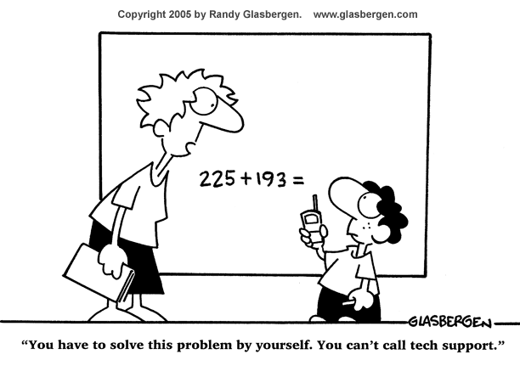
Oral reproduction
Essay writing
Write an essay based on the following picture.

Slide 93
Oral reproduction
Essay writing
You can follow the outline given below.
Part I. Beginning: description of the picture
1. Brief description of the picture;
2. Point out the effect: students depend too much on tech support.

Slide 94
Oral reproduction
Essay writing
You can follow the outline given below.
Part II. Body: causes of the problem
1. The rapid development of IT or smart technology;
2. The widespread application of online/distance learning;
3. The convenience advanced technology provides make students lazy.

Slide 95
Oral reproduction
Essay writing
You can follow the outline given below.
Part III. Conclusion: possible measures to the problem
1. Keep a balance between depending on tech support and our own;
2. Try to be the master of technology instead of the slave of it.

Slide 96
Oral reproduction
Essay writing
You may adopt the following expressions.
As it is depicted in the picture, …;
a fleet of laptops, smartphones and connectivity 24 hours a day;
get access to the Internet easily;
regulate and balance your time;
account for;
at a competitive disadvantage;
be indispensable for;
encourage sophisticated thinking;
Sb. say they really value …;
A recent study/research/experience found that …;
take you away from the real world outside

Slide 97

Paragraph translation
Translate a paragraph based on a summary of the text by using the expressions from the text.

Slide 98
Paragraph translation
大学校园正在转而进入电子设备的新时代。随着无线网络覆盖了校园的各个角落，大学因此也成为世界上网络最普及的地方。学生可以充分发挥互联网神奇的作用，来完成作业、复习讲座提纲、参加课堂讨论、与朋友进行网上社交。
being transformed into
the most Internet accessible spots in the world
wonder

Slide 99
Paragraph translation
同时，世界各地的大学已经将其老旧的计算机系统替换成免费的、最先进的网络系统。随时随地的网络连接使教育深受裨益。
In the meantime
replace with
yield amazing benefits
Samples

Slide 100
Paragraph translation
The college campus is being transformed into a new age of electronics. With many schools offering wireless Internet access anywhere on campus, colleges have become the most Internet accessible spots in the world. Students can use the wonders of the Internet to do homework, review lecture outlines, take part in class discussions and network online with your friends. In the meantime, colleges around the world have been replacing their old computer systems with a free and the most advanced online system. The anywhere-anytime access has already yielded amazing benefits in education.

Slide 101

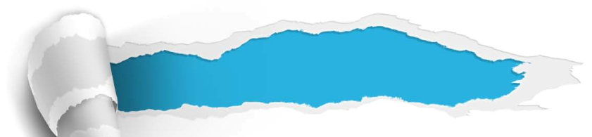
College life in the Internet age
Section A
Summary
Revision of
the useful expressions
Thematic study
Revision of
the functional patterns

Slide 102
Revision of
the useful expressions
Language points
— Functional expressions
1 新技术的前沿
2 源源不断的信息流
3 增加学生的兴奋感
4 深入思考
5 大学生活的动力
6 脱离现实世界
7 树立榜样，带头
8 自卑感
frontiers of new technology
ever-flowing river of information
add to student’s sense of excitement
sophisticated thinking
the fuel of college life
take sb. away from the real world outside
take the lead
inferiority complex

Slide 103
Revision of
the useful expressions
Language points — Useful expressions
at a competitive disadvantage
11 处于竞争劣势
12 脱颖而出
13 狂热
14 熬夜
15 同时
16 随时随地的
17 深受裨益
stand out
fever pitch
study late into the night
in the meantime
anywhere-anytime
yield amazing benefits

Slide 104
Revision of
the functional patterns
Language points — Useful patterns
Functions & Usages | Sentence Patterns
用于形容“某物的转变或变化”。
用于表达“某些研究、实验等所发现的结果”。
用于表达“某事或某物的发展或应用”。
Sth., long a … of …, is being transformed into …, and …
A recent study/ research/ experiment found/ discovered/ indicated that …
With the widespread application of …
With the fast/rapid development of …
Notes:
上面挤，下面空

Slide 105
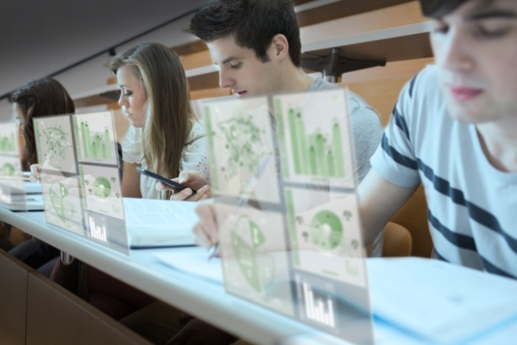


College life in the Internet age
Section A
The end

